Slide 1

SpaceX Falcon 9 first stage Landing Prediction Report
Vincent
22 April 2024

Slide 2
Executive Summary
This report analyse SpaceX Company’s launch data and establish a predictive model. This model will give a investment reference if we want to bid against SpaceX for a rocket launch
Firstly we will collection data from web and APIs, then we clean data, after that we will do a EDA and find relative variables for the model with visualization tools. Finally we reprocess the data and create four different model to test which one is optimized.
The success predict rate of final model is about 83% in test set

Slide 3
Introduction
In this report, we will predict if the Falcon 9 first stage will land successfully. SpaceX advertises Falcon 9 rocket launches on its website with a cost of 62 million dollars; other providers cost upward of 165 million dollars each, much of the savings is because SpaceX can reuse the first stage. Therefore if we can determine if the first stage will land, we can determine the cost of a launch. This information can be used if we wants to bid against SpaceX for a rocket launch.

Slide 4
Data collection and wrangling methodology
Collection data. Using request API and webscraping Launches Records from Wikipedia, extracting required data from html table
Dealing with Missing Values. Replace numerical data with mean and categorical data with median, delete rows with too many data missed
Filter Falcon 9 related data
Create a landing outcome label from column

Slide 5
EDA and interactive visual analytics methodology
SQL and Pandas for some descriptive statistics analysis
Matplotlib and Seaborn for static visualization
Folium for map visualization
Plotly and Dash for interactive visualization

Slide 6
Predictive analysis methodology
Linear Regression
Decision Tree
Support Vector Machine
K Nearest-Neighbors

Slide 7
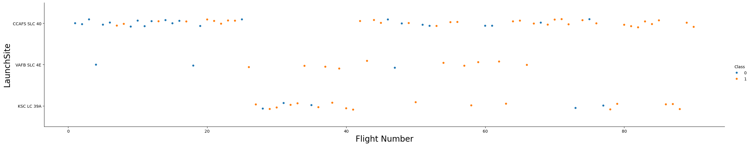
EDA with visualization results
In early age, launch mostly occurred in CCAFS SLC 40 with low launch success rate. Success rate increased by time.

Slide 8
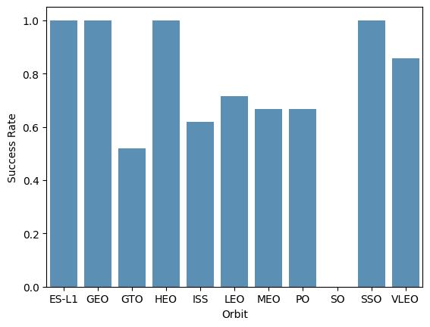
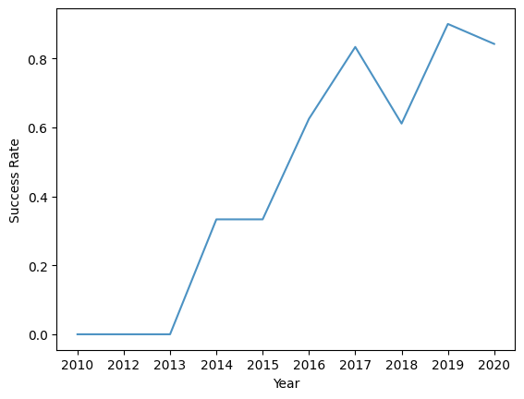
ES-L1, GEO, HEO, SSO and VLEO have success rate higher than 80%
The success rate since 2013 kept increasing till 2017 (stable in 2014) and after 2015 it started increasing

Slide 9
EDA with SQL results
There are four launch site: CCAFS LC-40, VAFB SLC-4E, KSC LC-39A, CCAFS SLC-40
Average payload mass carried by booster version F9 v1.1 is about 2534.7 kg
the names of the boosters which have success in drone ship and have payload mass greater than 4000 but less than 6000 are F9 FT B1026, F9 FT B1022, F9 FT B1021.2, F9 FT B1031.2

Slide 10
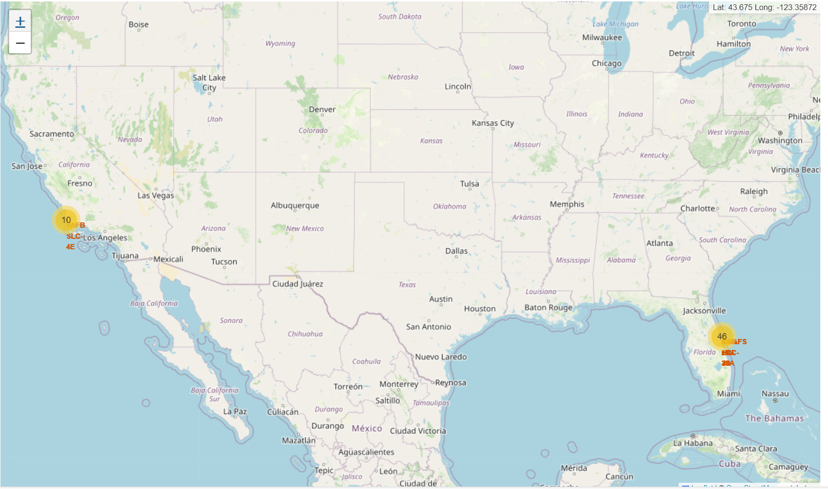
Interactive map with Folium-related
Most of launches is in Florida

Slide 11
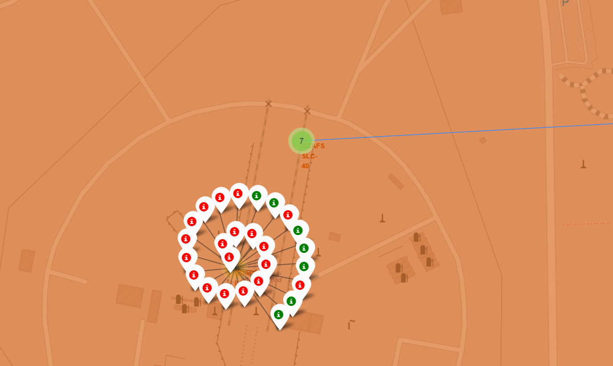

About 900m distance between launch site and coastline
In ccafs lc-40, most launches are failed

Slide 12
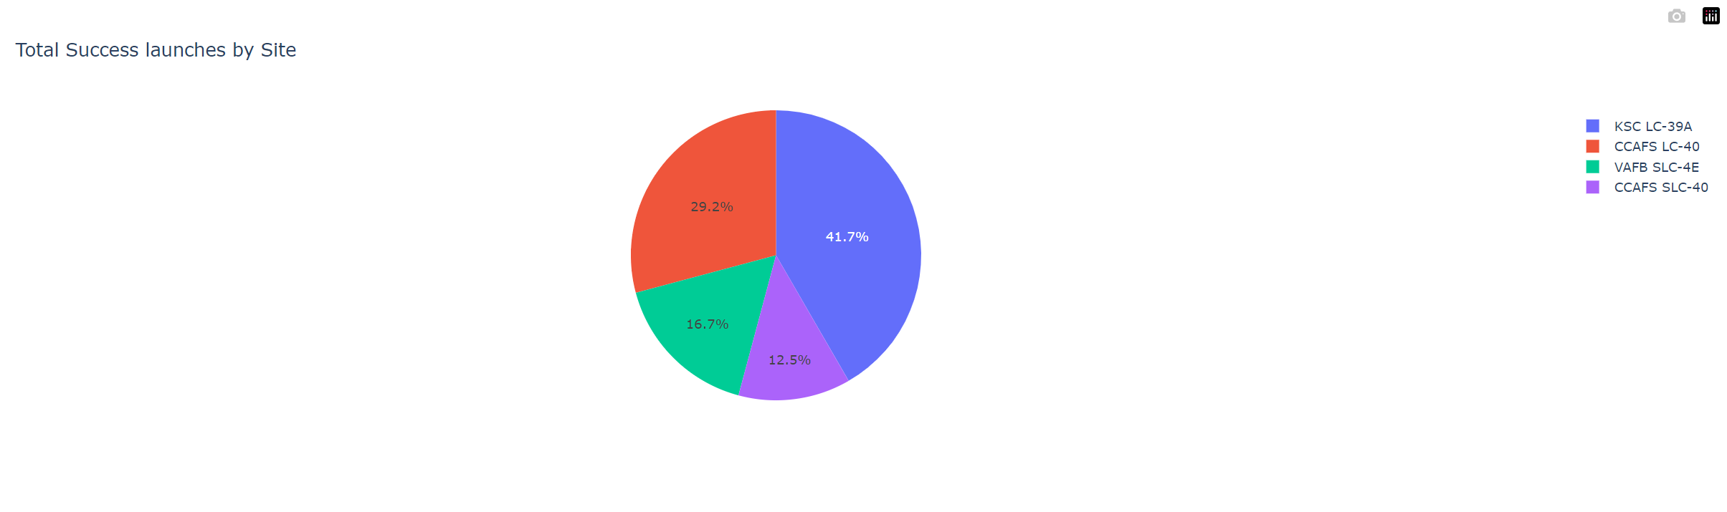
Plotly Dash-related

Slide 13
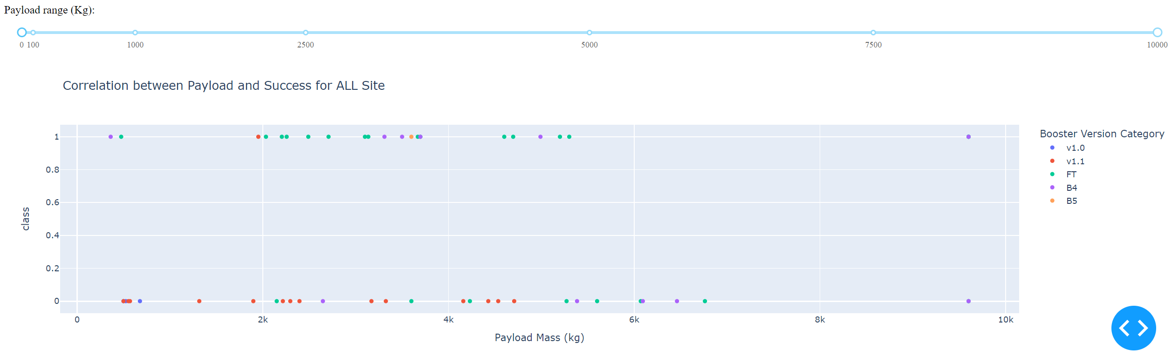

Slide 14
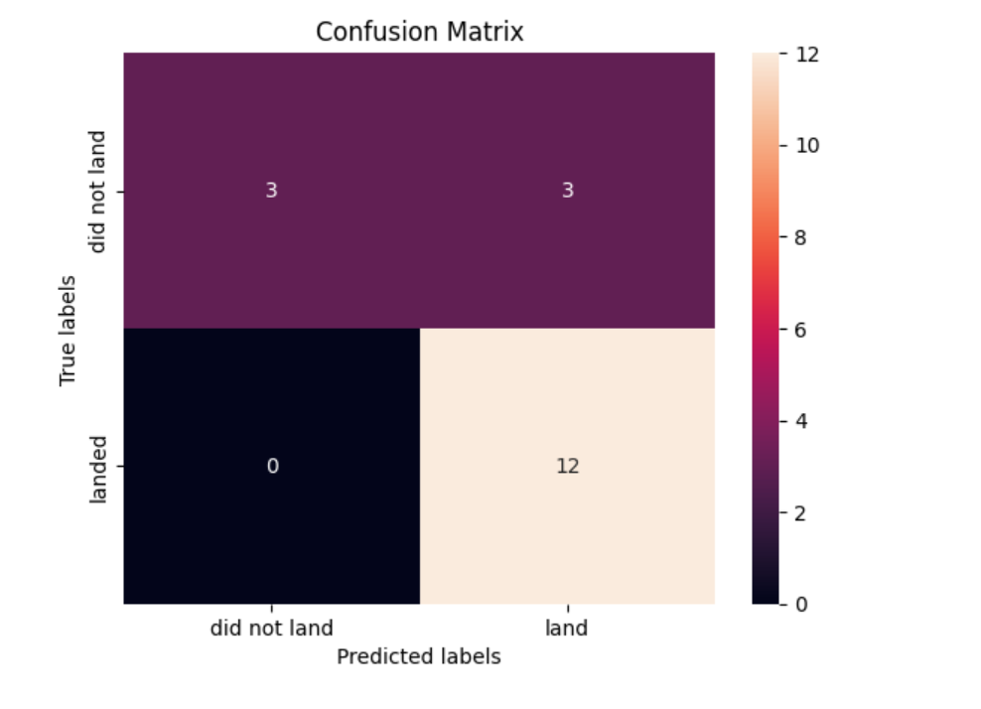
Predictive analysis result
Logistic regression, svm and knn have the same accuracy, same confusion matrix in test set.
The three method are all suitable in the case.
All about 83.3% accuracy in test site

Slide 15
Conclusion
We use the attributes: BoosterVersion, PayloadMass,Orbit, LaunchSite, Outcome, Flights, GridFins, Reused, Legs, LandingPad, Block, ReusedCount, Serial, Longitude, Latitude to predict launch success rate.
The model is about 83%accuracy
Launch site should close to equator and close to coastline
ES-L1, GEO, HEO, SSO and VLEO are recommended due to >80% success rate
We should expect higher than 80% success rate in the future

